Slide 1
Right Heart Catheterization

Slide 2
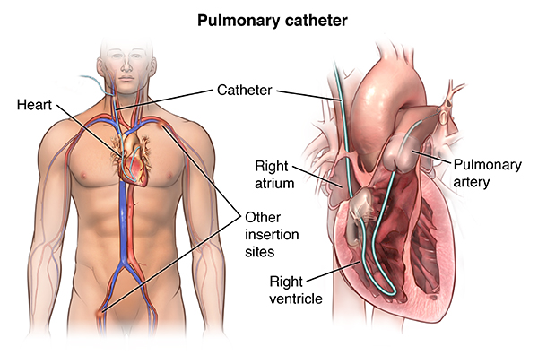
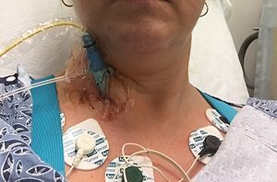
Background
Notes:
In a right-heart catheterization, your doctor guides a special catheter (a small, hollow tube) called a pulmonary artery (PA) catheter to the right side of your heart. He or she then passes the tube into your pulmonary artery, which is the main artery that carries blood to your lungs. Your doctor observes blood flow through your heart and measures the pressures inside your heart and lungs.

Slide 3
Background
Right Heart Catheterization (RHC):
A special catheter is guided to the right side of the heart
Special sensors in the catheter measure the pressure and blood flow inside the heart and lungs
The doctor might perform a right-heart catheterization in the diagnosis and/or management of Heart failure, Shock, Congenital heart disease, Valvular heart disease, Cardiomyopathy, Pulmonary hypertension.
Possible risks associated with a right-heart catheterization include:
Bruising of the skin at the site where the catheter is inserted
Excessive bleeding because of puncture of the vein during catheter insertion
Pneumothorax (partial collapse of the lung) if the neck or chest veins are used to insert the catheter
Other rare complications

Slide 4
Background
Many cardiologists and critical care physicians believe that the direct measurement of cardiac function provided by RHC is necessary to guide therapy for certain critically ill patients and that such management leads to better patient outcomes. While the benefit of RHC has not been demonstrated in a randomized controlled trial (RCT), the popularity of this procedure and the widespread belief that it is beneficial make the performance of an RCT difficult.
The paper published by Connors et al. in J American Medical Association (1996) questioned this widespread belief by analyzing the data of an observational study and concluded that RHC was associated with increased mortality and increased utilization of resources, after adjustment for treatment selection bias.

Slide 5
Background
The Study to Understand Prognoses and Preferences for Outcomes and Risks of Treatments (SUPPORT) was a 5-center study of decision making and outcomes of seriously ill, hospitalized adult patients.
5 medical centers participated in data collection.
SUPPORT subjects included all patients meeting severity and other entry criteria, which were designed to identify patients with an aggregate 6-month mortality of 50%, in 1 or more of 9 disease categories on admission to the hospital.
In this analysis, we include all 5735 SUPPORT patients who were admitted to or transferred to an ICU in the first 24 hours after entering the study.

Slide 6
Data set
Outcome of interest: patient survival time
Covariates:
Chart abstraction (nurse): admission diagnosis (33 covariates) and comorbidities illness (12 covariates)
Interviews (trained interviewers): age, sex, race, education, income, insurance, primary and secondary disease category (8 covariates)
Primary interest: RHC( variable name: swang1) and its interaction with other covariates

Slide 7
Data cleaning
Total 5735 observations
Urin1 has 3028 missing values.
-replace missing data with mean (2192.454)
Adld3p has 4296 missing values.
-replace missing data with mean (1.182071)
Final dataset: 5735 observations
3842 observations for model building
1893 observations for model validation

Slide 8
Descriptive Statistics (Continuous)
Covariates | Min | Max | No RHC (3551) |  | RHC (2184) |  | p-value
 |  |  | Mean | Std. Dev | Mean | Std. Dev
edu | 0 | 30 | 11.57 | 3.13 | 11.86 | 3.16 | 0.00079**
surv2md1 | 0 | 0.96 | 0.61 | 0.19 | 0.57 | 0.20 | <0.0001**
aps1 | 3 | 147 | 50.93 | 18.81 | 60.74 | 20.27 | <0.0001**
scoma1 | 0 | 100 | 22.25 | 31.37 | 18.97 | 28.26 | <0.0001**
Meanbp1 | 0 | 259 | 84.87 | 38.87 | 68.20 | 34.24 | <0.0001**
Wblc1 | 0 | 192 | 15.26 | 11.41 | 16.27 | 12.55 | 0.00239**
Hrt1 | 0 | 250 | 112.87 | 40.94 | 118.93 | 41.47 | <0.0001**
Resp1 | 0 | 100 | 28.98 | 13.95 | 26.65 | 14.17 | <0.0001**
Pafi1 | 11.60 | 937.5 | 240.63 | 116.66 | 192.43 | 105.54 | <0.0001**
Alb1 | 0.30 | 29 | 3.16 | 0.67 | 2.98 | 0.93 | <0.0001**
Hema1 | 2 | 66.19 | 32.70 | 8.79 | 30.51 | 7.42 | <0.0001**
Bili1 | 0.10 | 58.20 | 1.99 | 4.43 | 2.71 | 5.33 | <0.0001**
Crea1 | 0.10 | 25.10 | 1.92 | 2.03 | 2.47 | 2.05 | <0.0001**
Sod1 | 101 | 178 | 137.04 | 7.68 | 136.33 | 7.60 | 0.00069**
Paco21 | 1 | 156 | 39.95 | 14.24 | 36.79 | 10.97 | <0.0001**
Ph1 | 6.58 | 7.77 | 7.39 | 0.11 | 7.38 | 0.11 | <0.0001**
Wtkilo1 | 0 | 244 | 65.04 | 29.50 | 72.36 | 27.73 | <0.0001**
Covariates | Min | Max | No RHC (3551) |  | RHC (2184) |  | p-value
 |  |  | Mean | Std. Dev | Mean | Std. Dev
age | 18.04 | 101.848 | 61.76 | 15.63 | 60.75 | 17.29 | 0.02243
das2d3pc | 11 | 33 | 20.37 | 5.48 | 20.70 | 5.03 | 0.0201
Temp1 | 27 | 43 | 37.63 | 1.74 | 37.59 | 1.83 | 0.4346
Pot1 | 1.10 | 11.90 | 4.08 | 1.04 | 4.05 | 1.01 | 0.3183
Adld3p | 0 | 7 | 1.24 | 1.86 | 1.02 | 1.69 | 0.0271
Urin1 | 0 | 9000 | 2199.18 | 1445.2 | 2182.67 | 1635.02 | 0.7868

Slide 9
Descriptive Statistics (Categorical)
Covariate |  | No RHC (3551) |  | RHC (2184) |  | p-value
 |  | Mean | Percentage | Mean | Percentage
cardiohx | No Yes | 2984 567 | 84.03% 15.97% | 1738 446 | 79.58% 20.42% | <0.0001
dementhx | No Yes | 3138 413 | 88.37% 11.63% | 2033 151 | 93.09% 6.91% | <0.0001
psychhx | No Yes | 3265 286 | 91.95% 8.05% | 2084 100 | 95.42% 4.58% | <0.0001
chrpulhx | No Yes | 2777 774 | 78.20% 21.80% | 1869 315 | 85.58% 14.42% | <0.0001
mailghx | No Yes | 2679 872 | 75.44% 24.56% | 1740 444 | 79.67% 20.33% | 0.00024
immunhx | No Yes | 2644 907 | 74.46% 25.54% | 1548 636 | 70.88% 29.12% | 0.0033
transhx | No Yes | 3216 335 | 90.57% 9.43% | 1857 327 | 85.03% 14.97% | <0.0001
amihx | No Yes | 3446 105 | 97.04% 2.96% | 2089 95 | 95.66% 4.35% | 0.00657
dnr1 | No Yes | 3052 499 | 85.95% 14.05% | 2029 155 | 92.90% 7.10% | <0.0001
resp | No Yes | 2070 1481 | 58.29% 41.71% | 1552 632 | 71.06% 28.94% | <0.0001
card | No Yes | 2544 1007 | 71.64% 28.36% | 1260 924 | 57.69% 42.31% | <0.0001
neuro | No Yes | 2976 575 | 83.81% 16.19% | 2066 118 | 94.60% 5.40% | <0.0001
gastr | No Yes | 3029 522 | 85.30% 14.70% | 1764 420 | 80.77% 19.23% | <0.0001
renal | No Yes | 3404 147 | 95.86% 4.14% | 2036 148 | 93.22% 6.78% | <0.0001
seps | No Yes | 3036 515 | 85.50% 14.50% | 1668 516 | 76.37% 23.63% | <0.0001
trauma | No Yes | 3533 18 | 99.49% 0.51% | 2150 34 | 98.44% 1.56% | <0.0001
Covariates |  | No RHC (3551) |  | RHC (2184) |  | p-value
 |  | Mean | Percentage | Mean | Percentage
cat1 | ARF CHF Cirrhosis Colon Cancer Coma COPD Lung Cancer MOSF w/Malignancy MOSF w/Sepsis | 1581 247 175 6 341 399 34 241 527 | 44.52% 6.96% 4.93% 0.17% 9.6% 11.24% 0.96% 6.78% 14.84% | 909 209 49 1 95 58 5 158 700 | 41.62% 9.57% 2.24% 0.05% 4.35% 2.66% 0.23% 7.23% 32.03% | 0.0336 0.0005 <0.0001 0.3639 <0.0001 <0.0001 0.00197 0.5528 <0.0001
ca | Metastatic No Yes | 261 2652 638 | 7.35% 74.68% 17.97% | 123 1727 334 | 5.63% 79.08% 15.29% | 0.01388 0.00016 0.00975
ninsclas | Medicaid Medicare Medicare & Medicaid No insurance Private Private $ Medicare | 454 947 251 186 967 746 | 12.79% 26.67% 7.07% 5.24% 27.23% 21.00% | 193 511 123 135 731 490 | 8.84% 23.40% 5.63% 6.18% 33.47% 22.44% | <0.0001 0.0063 0.03711 0.1283 <0.0001 0.2136
income | $11-$25k $25-$50k >$50k Under$11k | 713 500 257 2081 | 20.08% 14.08% 7.24% 58.60% | 452 393 194 1145 | 20.70% 17.99% 8.88% 52.43% | 0.5959 <0.0001 0.028 <0.0001
hema | No Yes | 3312 239 | 93.27% 6.73% | 2069 115 | 94.73% 5.27% | 0.02911
ortho | No Yes | 3548 3 | 99.92% 0.08% | 2180 4 | 99.82% 0.18% | 0.5158
race | Black Other white | 585 213 2753 | 16.47% 6.00% 77.53% | 335 142 1707 | 15.34% 6.50% 78.16% | 0.271 0.4765 0.5988
chfhx | No Yes | 2955 596 | 83.22% 16.78% | 1759 425 | 80.54% 19.46& | 0.01119
renalhx | No Yes | 3402 149 | 95.80% 4.20% | 2078 106 | 95.15% 4.85% | 0.2683
liverhx | No Yes | 3286 265 | 92.54% 7.46% | 2048 136 | 93.77% 6.23% | 0.08392
gibledhx | No Yes | 3420 131 | 96.31% 3.69% | 2130 54 | 97.53% 2.47% | 0.01408

Slide 10
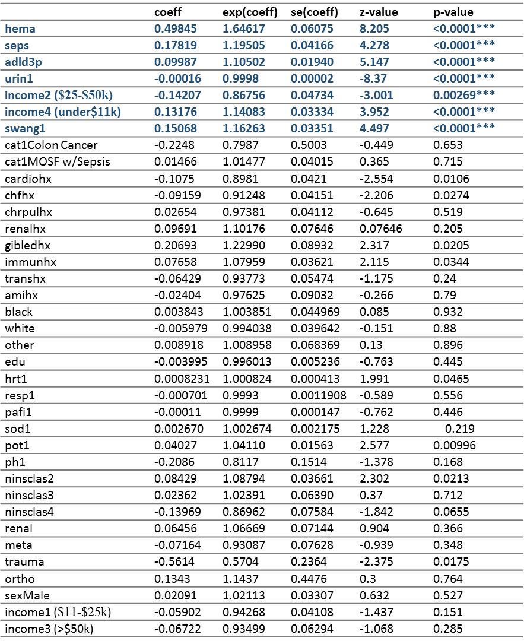
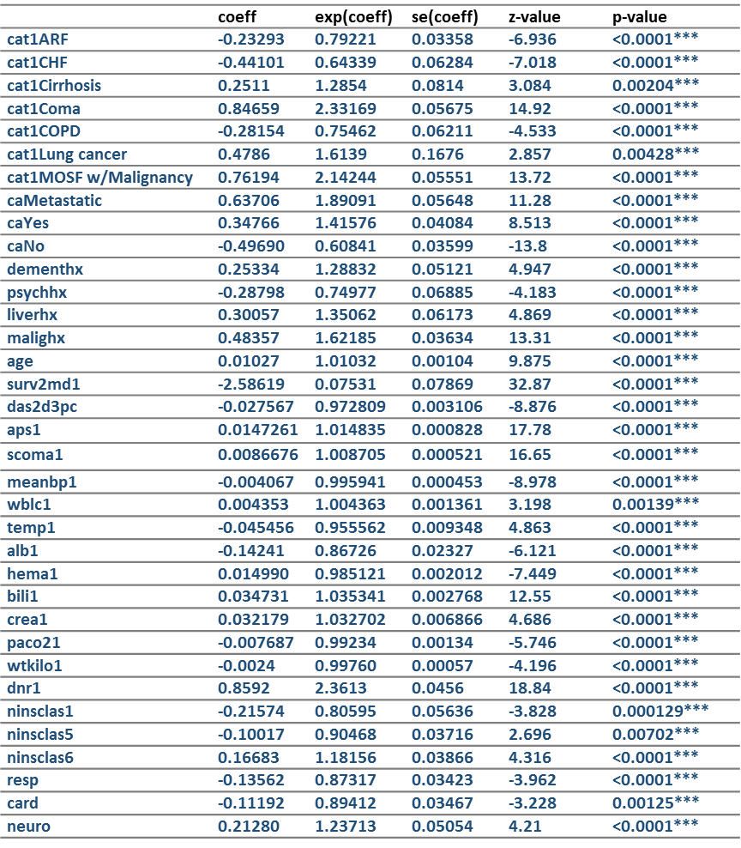
Univariate Analysis

Slide 11
Full Model
Surv(time, death1) ~ cat12 + cat13 + cat14 + cat15 + cat16 + cat17 + cat18 + cat19 + caN + caY + cardiohx + chfhx + dementhx + psychhx + chrpulhx + renalhx + liverhx + gibledhx + malighx + +immunhx + transhx + amihx + age + sex + edu + surv2md1 + das2d3pc + aps1 + scoma1 + meanbp1 + wblc1 + hrt1 + resp1 + temp1 + pafi1 + alb1 + hema1 + bili1 + crea1 + sod1 + pot1 + paco21 + ph1 + swang1 + wtkilo1 + dnr1 + resp + card + neuro + gastr + renal + meta + hema + seps + trauma + ortho + ninsclas2 + ninsclas3 + ninsclas4 + ninsclas5 + ninsclas6 + black + white + income2 + income3 + income4 + urin11 + adld3p1
Likelihood ratio test : 1043 on 68 df, p=0
Wald test :1132 on 68 df, p=0
Score (logrank) test : 1207 on 68 df, p=0

Slide 12
Reduced model (backward elimination)
Surv(time, death1) ~ cat15 + cat17 + cat18 + gibledhx + age + sex + surv2md1 + das2d3pc + aps1 + hrt1 + bili1 + pot1 + swang1 + dnr1 + hema + income4 + urin11
Likelihood ratio test : 974.1 on 17 df, p=0
Wald test :1069 on 17 df, p=0
Score (logrank) test : 1133 on 17 df, p=0
LRT on 51 degree of freedom
LRT=68.72 is less than Chisq (0.99,51)=77.386

Slide 13
Results (reduced model)
 | coef | exp(coef) | se(coef) | z | Pr(>|z|)
cat15 | 0.6481 | 1.912 | 0.08583 | 7.551 | <0.0001
cat17 | 0.774 | 2.169 | 0.2024 | 3.824 | 0.000131
cat18 | 0.3565 | 1.428 | 0.07986 | 4.464 | <0.0001
gibledhx | 0.5808 | 1.787 | 0.1065 | 5.453 | <0.0001
age | 0.004512 | 1.005 | 0.00145 | 3.111 | 0.001864
sexMale | 0.1167 | 1.124 | 0.04125 | 2.829 | 0.004666
surv2md1 | -1.703 | 0.1822 | 0.1503 | -11.331 | <0.0001
das2d3pc | -0.02377 | 0.9765 | 0.004124 | -5.764 | <0.0001
aps1 | 0.003576 | 1.004 | 0.001354 | 2.64 | 0.008291
hrt1 | 0.00151 | 1.002 | 0.000506 | 2.981 | 0.002868
bili1 | 0.02475 | 1.025 | 0.00394 | 6.281 | <0.0001
pot1 | 0.05202 | 1.053 | 0.01946 | 2.674 | 0.007503
swang1RHC | 0.1902 | 1.21 | 0.04421 | 4.303 | <0.0001
dnr1Yes | 0.5635 | 1.757 | 0.06051 | 9.313 | < 0.0001
hemaYes | 0.2346 | 1.264 | 0.08057 | 2.912 | 0.00359
income4 | 0.1433 | 1.154 | 0.0424 | 3.38 | 0.000724

Slide 14
Transformation
Use martingale residuals to find the functional form of covariates.
For all covariates that are in the model after the backward model selection procedure, Plot martingale residuals vs each covariate, there are no apparent patterns.
Thus, the linear form for each covariate is appropraite.

Slide 15
Checking PH assumption
Log-log curves
Crossing: cat15,cat17,cat18
No crossing: surv2md1,dnr1,income
Time-varying covariate effects
 | rho | chisq | p
cat15 | -0.0606 | 9.6348 | 0.00191
cat17 | 0.02741 | 1.8838 | 0.17
cat18 | 0.07632 | 14.8064 | 0.000119
gibledhx | -0.01924 | 0.9022 | 0.342
age | 0.04718 | 5.4233 | 0.0199
sexMale | -0.00571 | 0.0801 | 0.777
surv2md1 | 0.07381 | 14.4851 | 0.000141
das2d3pc | -0.02676 | 1.5485 | 0.213
aps1 | -0.0354 | 3.3322 | 0.0679
hrt1 | -0.04012 | 4.0473 | 0.0442
bili1 | -0.03289 | 2.2314 | 0.135
pot1 | 0.0523 | 6.8245 | 0.00899
swang1RHC | -0.07346 | 14.1388 | 0.00017
dnr1Yes | -0.09402 | 23.1709 | 1.48E-06
hemaYes | -0.04612 | 5.2785 | 0.0216
income4 | -0.05525 | 7.722 | 0.00546
urin11 | 0.02035 | 1.2458 | 0.264
GLOBAL | NA | 167.1904 | 0

Slide 16
Model after stratification
 | coef | exp(coef) | se(coef) | z | Pr(>|z|)
gibledhx | 0.5814 | 1.788 | 0.1065 | 5.46 | <0.0001
age | 0.004508 | 1.005 | 0.001456 | 3.096 | 0.00196
sexMale | 0.1193 | 1.127 | 0.04133 | 2.886 | 0.003904
surv2md1 | -1.726 | 0.178 | 0.1509 | -11.435 | <0.0001
das2d3pc | -0.02397 | 0.9763 | 0.004127 | -5.81 | <0.0001
aps1 | 0.002911 | 1.003 | 0.00135 | 2.156 | 0.031074
bili1 | 0.02572 | 1.026 | 0.003934 | 6.537 | <0.0001
swang1RHC | 0.1875 | 1.206 | 0.04426 | 4.235 | <0.0001
dnr1Yes | 0.5563 | 1.744 | 0.0607 | 9.164 | <0.0001
hrt1 | 0.001735 | 1.002 | 0.000506 | 3.427 | 0.000609
pot1 | 0.04885 | 1.05 | 0.01948 | 2.507 | 0.012164
hemaYes | 0.2375 | 1.268 | 0.08071 | 2.943 | 0.003249
income4 | 0.1378 | 1.148 | 0.04253 | 3.241 | 0.001192
urin11 | -8.9E-05 | 0.9999 | 2.29E-05 | -3.882 | 0.000104
P-values for aps1 and pot1 become larger after the stratification
Perform backward elimination again
After removing aps1, pot1 becomes significant.

Slide 17
Final model
coxph(Surv(time,death1)~strata(cat15) + strata(cat17) + strata(cat18) + gibledhx + age + sex + surv2md1 + das2d3pc + bili1 + swang1 + dnr1 + hrt1 + pot1 + hema + income4 + urin11
Likelihood ratio test: 695.2 on 13 df, p=0
Wald test : 737.2 on 13 df, p=0
Score (logrank) test : 768.8 on 13 df, p=0
LRT
LRT=4.64 is less than Chisq (0.99,1)=6.635

Slide 18
Interactions
Considering interactions
swang1 and age (p-value is 0.742)
swang1 and sex (p-value is 0.506)
swang1 and hrt1 (p-value is 0.623371)
No interactions added to the model.
The final model is:
coxph(Surv(time,death1)~strata(cat15) + strata(cat17) + strata(cat18) + gibledhx + age + sex + surv2md1 + das2d3pc + bili1 + swang1 + dnr1 + hrt1 + pot1 + hema + income4 + urin11

Slide 19
Results (Final model)
coxph(Surv(time,death1)~strata(cat15) + strata(cat17) + strata(cat18) + gibledhx + age + sex + surv2md1 + das2d3pc + bili1 + swang1 + dnr1 + hrt1 + pot1 + hema + income4 + urin11
 | coef | exp(coef) | se(coef) | z | Pr(>|z|)
gibledhx | 0.5598 | 1.75 | 0.106 | 5.28 | <0.0001
age | 0.004085 | 1.004 | 0.001445 | 2.827 | 0.004704
sexMale | 0.1226 | 1.13 | 0.04131 | 2.967 | 0.003007
surv2md1 | -1.897 | 0.1501 | 0.128 | -14.81 | <0.0001
das2d3pc | -0.02416 | 0.9761 | 0.004125 | -5.858 | <0.0001
bili1 | 0.02755 | 1.028 | 0.003823 | 7.205 | <0.0001
swang1RHC | 0.2007 | 1.222 | 0.04384 | 4.58 | <0.0001
dnr1Yes | 0.559 | 1.749 | 0.06069 | 9.211 | <0.0001
hrt1 | 0.001963 | 1.002 | 0.000498 | 3.941 | <0.0001
pot1 | 0.05506 | 1.057 | 0.01932 | 2.85 | 0.004374
hemaYes | 0.2505 | 1.285 | 0.08042 | 3.114 | 0.001843
income4 | 0.1399 | 1.15 | 0.0425 | 3.292 | 0.000995
urin11 | -9.5E-05 | 0.9999 | 2.28E-05 | -4.172 | <0.0001

Slide 20
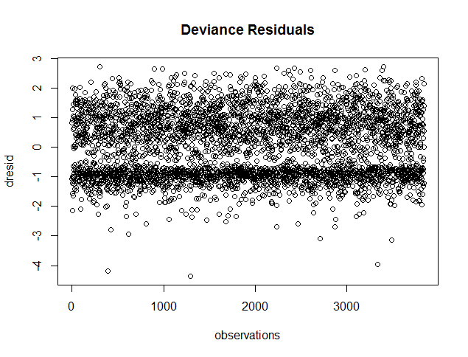
Outliers
die earlier than expected:
396 1295
2707 3335
3487
live longer than expected:
303 865
2231 2425
3401

Slide 21
Influential points
 | most influential
gibledhx | 865
age | 3335
sexMale | 3335
surv2md1 | 3335
das2d3pc | 1295
bili1 | 2167
swang1RHC | 1295
dnr1Yes | 3335
hrt1 | 3099
pot1 | 396
hemaYes | 422
income4 | 2865
urin11 | 2487
Keep those data as they are since we have no evidence that they are incorrectly collected.

Slide 22
Model validation
 | coef (learning) | se (learning) | coef (validation) | se (validation)
gibledhx | 0.5598 | 0.1060 | 0.2987 | 0.0927
age | 0.004085 | 0.0014 | 0.0037 | 0.0012
sexMale | 0.1226 | 0.0413 | 0.1037 | 0.0337
surv2md1 | -1.897 | 0.1280 | -1.9664 | 0.1047
das2d3pc | -0.02416 | 0.0041 | -0.0239 | 0.0034
bili1 | 0.02755 | 0.0038 | 0.0272 | 0.0030
swang1RHC | 0.2007 | 0.0438 | 0.1488 | 0.0354
dnr1Yes | 0.559 | 0.0607 | 0.5928 | 0.0492
hrt1 | 0.001963 | 0.0005 | 0.0025 | 0.0004
pot1 | 0.05506 | 0.0193 | 0.0233 | 0.0161
hemaYes | 0.2505 | 0.0804 | 0.2522 | 0.0661
income4 | 0.1399 | 0.0425 | 0.1119 | 0.0342
urin11 | -0.0001 | 0.0000 | -0.0001 | 0.0000

Slide 23
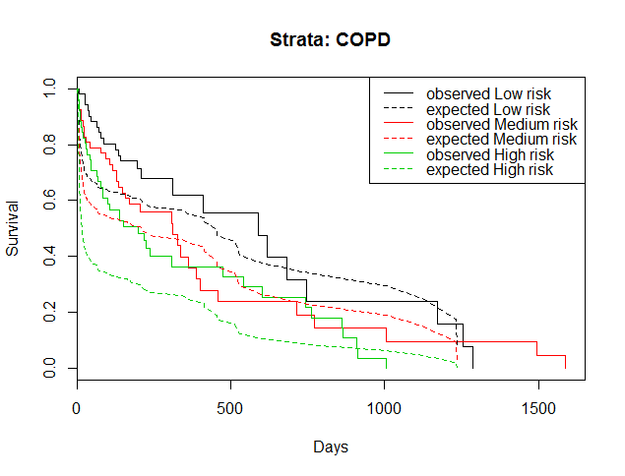
Model validation

Slide 24
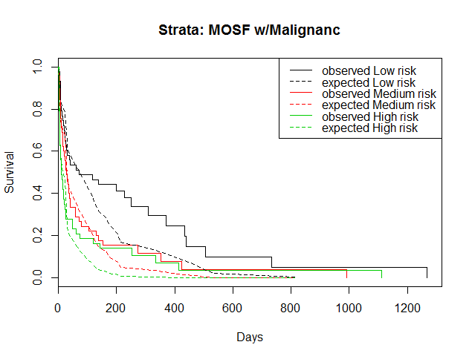
Model validation

Slide 25
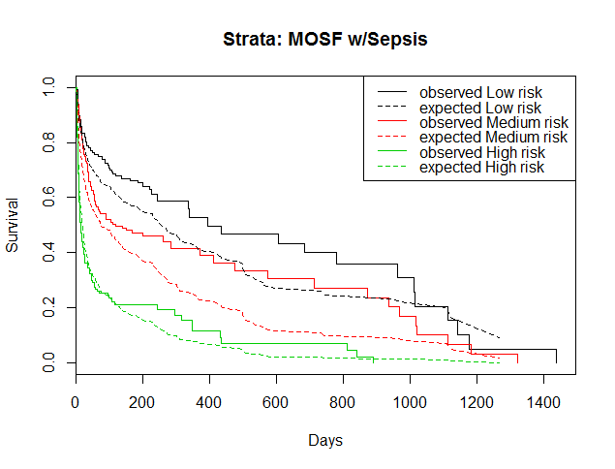
Model validation

Slide 26
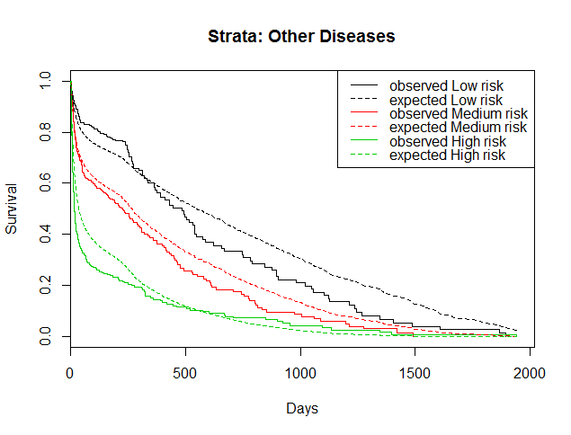
Model validation

Slide 27
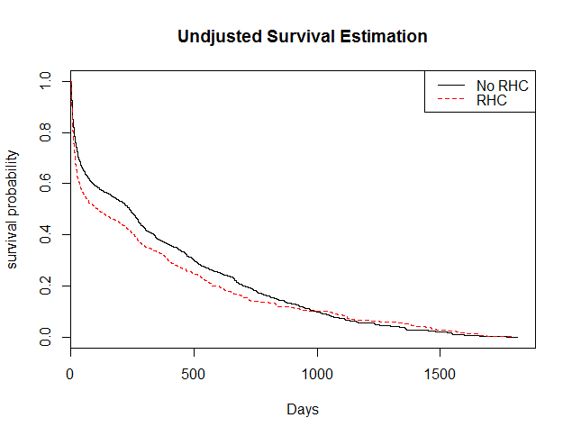
RHC vs. NO RHC (KM-estimator)

Slide 28
References
"Right Heart Catheterization Dataset." Right Heart Catheterization Dataset. N.p., 27 Dec. 2002. Web. 26 Apr. 2016.
http://www.hopkinsmedicine.org/healthlibrary/
https://en.wikipedia.org/wiki/Cardiac_catheterization

